Slide 1
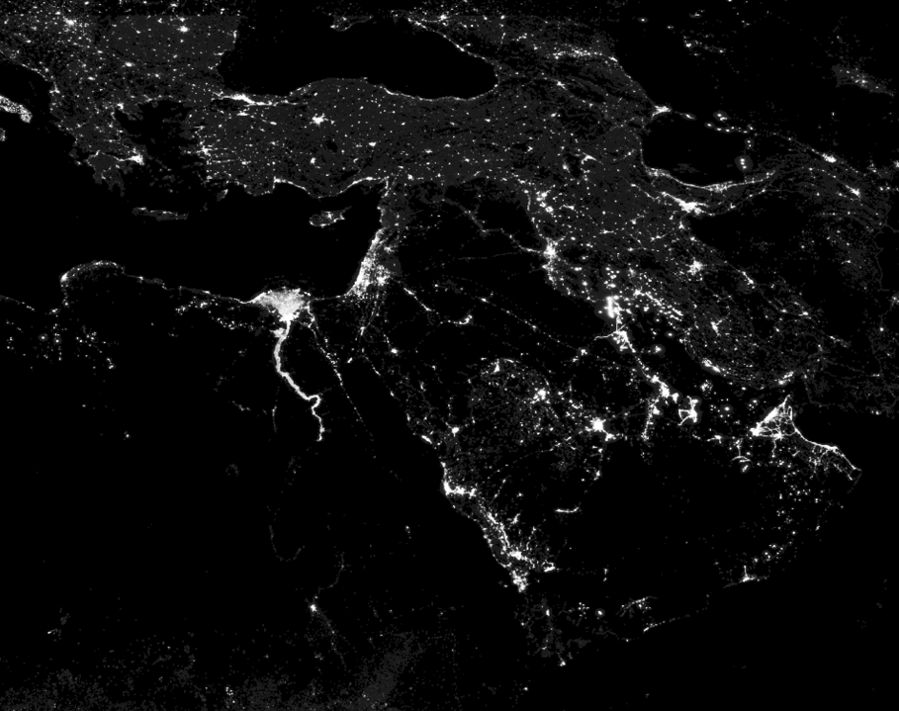
Nighttime Light Dynamics during Syrian Civil War

Slide 2
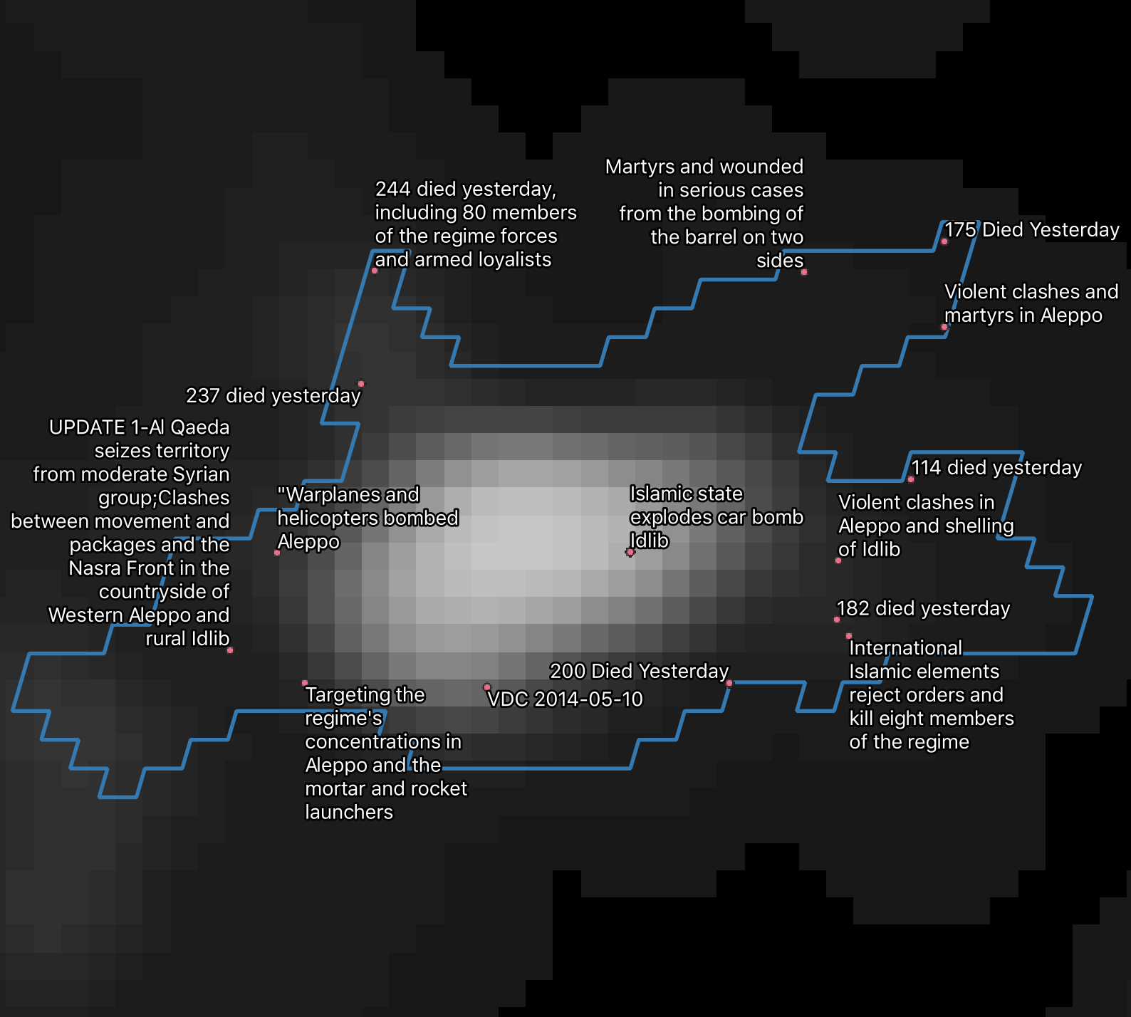
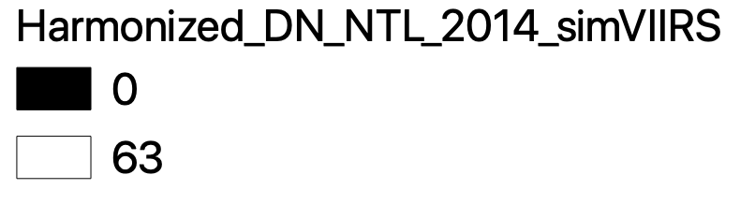
Methodology Consistent measurement of nighttime lights (NTL) across time and across cities 1. Summarize nighttime lights raster datasets based on urban center geometries 2. Match to UCDP database of violent events
Consistent nighttime lights dataset for 1992-2018
DMSP (1992–2013) and VIIRS (2012–2018)
Urban areas in the Middle East
Georeferenced violence data
Example: Halab (Aleppo) [SYR] 2014
Source: Li, Zhou, Zhao, & Zhao (2020)
Source: GHS SMOD
Source: Uppsala Conflict Data Program
Zonal statistics: mean median min max count sum std cv

Slide 3
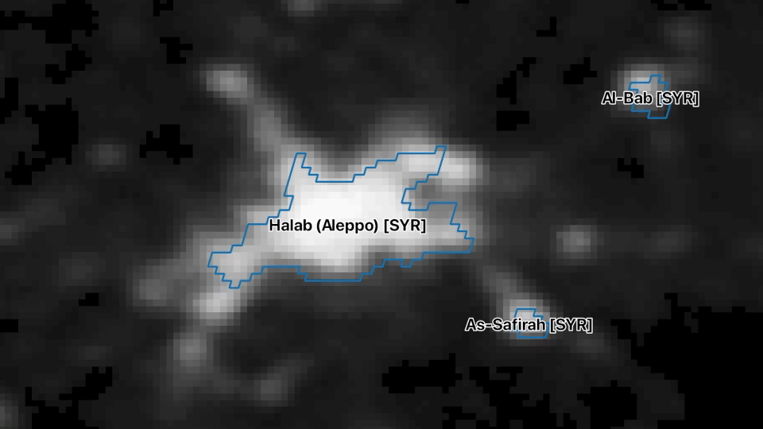
Nighttime Light Dynamics 2012 - 2018

Slide 4
Figure 1: Drop in NTL in Syrian cities
Data source: Harmonization of DMSP and VIIRS nighttime light data from 1992-2018 at the global scale
Urban Areas defined by GHS SMOD

Slide 5
Figure 2: Higher variation in NTL in Syrian cities
Data source: Harmonization of DMSP and VIIRS nighttime light data from 1992-2018 at the global scale
Urban Areas defined by GHS SMOD

Slide 6
Figure 3: Correlation with geo-referenced violence data in Syrian cities
Blue = NTL Mean Red = Conflict data
Blue = NTL CV Red = Conflict data

Slide 7
Figure 3: Correlation with geo-referenced violence data in Syrian cities
Blue = NTL Mean Red = Conflict data
Blue = NTL CV Red = Conflict data

Slide 8
Figure 4: Correlation with geo-referenced violence data in southeastern Turkish cities
Blue = NTL Mean Red = Conflict data
Blue = NTL CV Red = Conflict data

Slide 9
Figure 5: Correlation with geo-referenced violence data in any other region
Blue = NTL Mean Red = Conflict data
Blue = NTL CV Red = Conflict data
Population = 884,122
Population = 457,400
Population = 752,490
Population = 556,000

Slide 10
Next steps
Geography of NTL changes
Proximity of city to violent events
Proximity of neighborhoods to violent events
How conflict changed urban morphology and expansion trends
Temporal vs. permanent changes
Measure of economic impact through NTL changes
Proxy for local GDP
Correlation with refugees flows

